Slide 1
Welcome
To
6-Day’s workshop
On
Python Programming For Modern Application Development

Slide 2

Trainer’s Profile
Name- Yogesh Raje
Over 21 Years of training and teaching experience.
Trained over 1500 engineers through workshops and webinars on Python Programming, Data Science ,AI-Machine Learning and Deep Learning.
Intel Certified Instructor for Machine Learning using OneAPI, OneAPI DPC++ Essentials, OneAPI Rendering Toolkits, OneAPI OpenMP Offload Basics
LinkedIn : https://www.linkedin.com/in/yogesh-raje/
Currently serves as Master Trainer.
Helps learners with AI and DS every day!

Slide 3
Agenda
oneAPI and its Toolkits
Intel DevCloud for oneAPI
Intel Distribution of Python
Executing python program on different accelerators : CPU ,GPU and FPGA
Python Data Structure basics and Object-Oriented programming
Python decorators and Parallelism
Data Analytics Libraries
Intel SDC library and Handling data using Intel SDC

Slide 4
Agenda-Day1
oneAPI and its Toolkits
Intel DevCloud for oneAPI
Intel Distribution of Python
Executing python program on different accelerators : CPU ,GPU and FPGA
Python Data Structure basics : introduction to python data structure, Python comparison operators, Python statements and functions

Slide 5
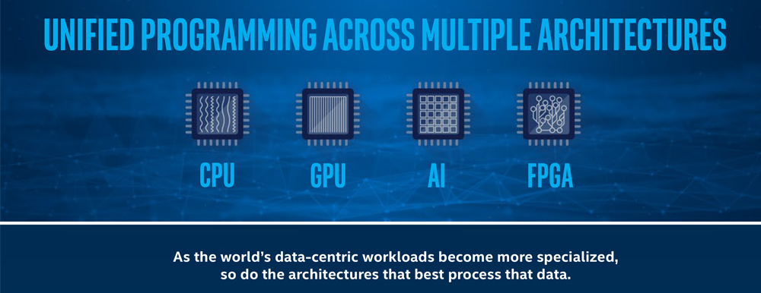
Intel oneAPI
Notes:
What is OneAPI
oneAPI is an open, cross-industry, standards-based, unified, multiarchitecture, multi-vendor programming model that delivers a common developer experience across accelerator architectures – for faster application performance, more productivity, and greater innovation. The oneAPI initiative encourages collaboration on the oneAPI specification and compatible oneAPI implementations across the ecosystem.
-visit https://www.oneapi.io/
-Explore Elements of oneAPI at url https://www.oneapi.io/spec/
-SPEC 1.1

Slide 6
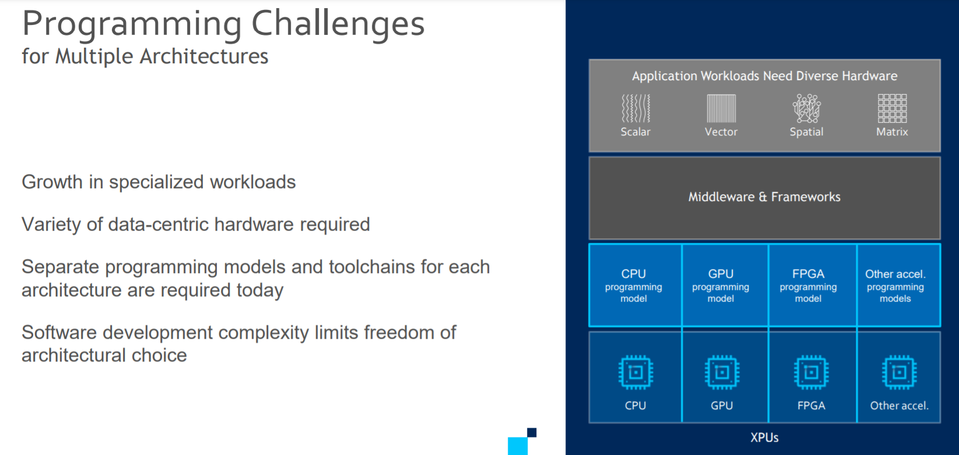

Slide 7
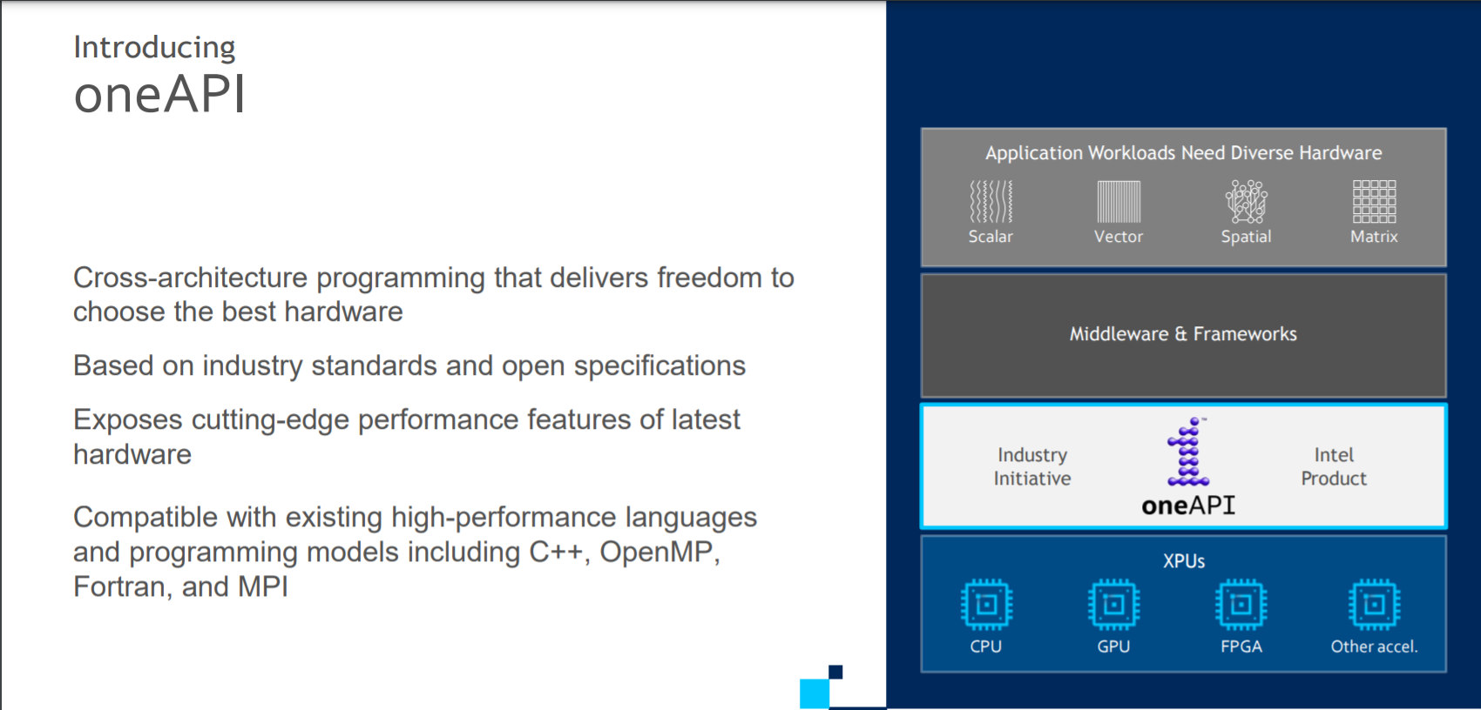

Slide 8
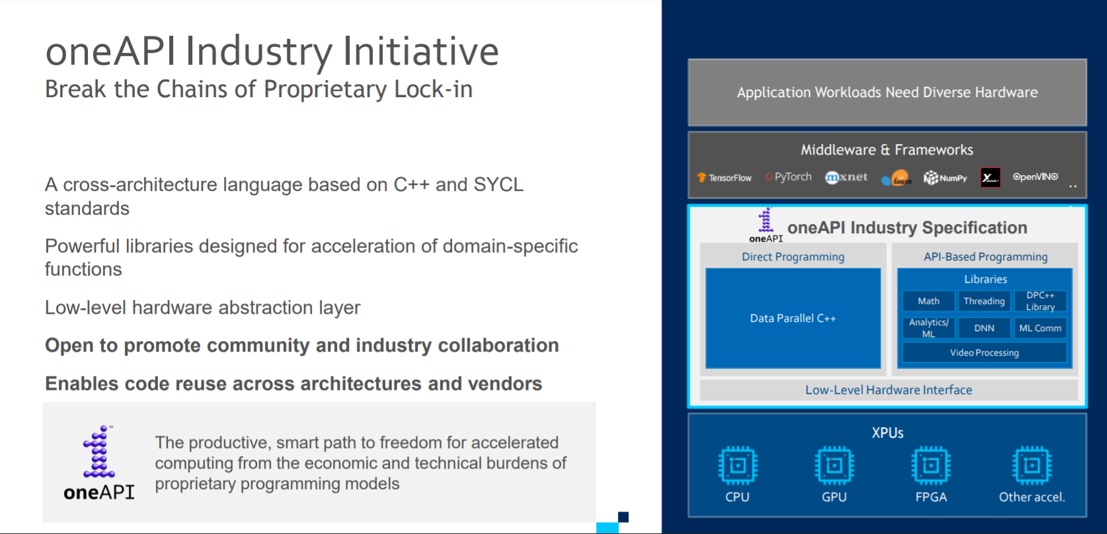

Slide 9
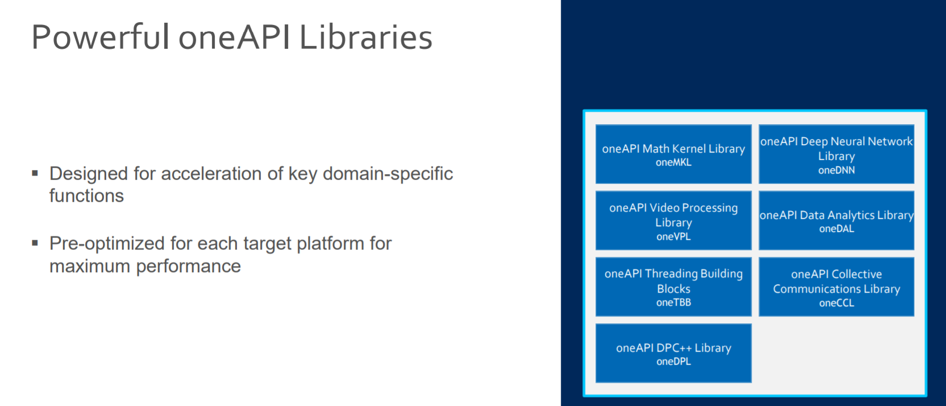

Slide 10
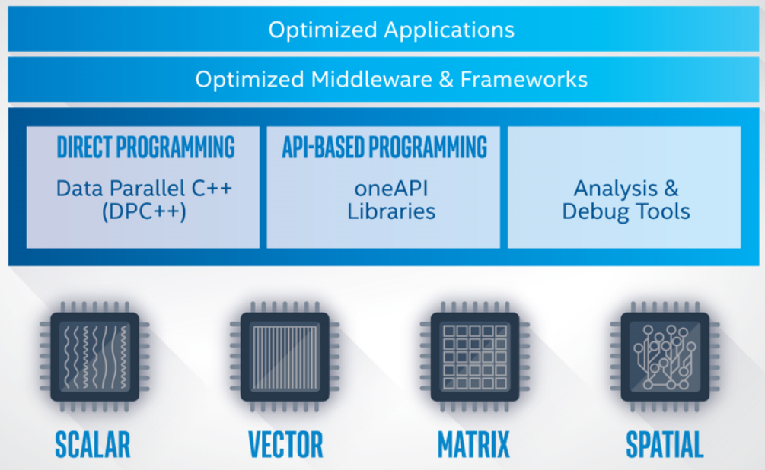
Intel OneAPI - Cross Architecture Performance
oneAPI is a cross-industry, open, standards-based unified programming model that delivers a common developer experience across accelerator architectures—for faster application performance, more productivity, and greater innovation.
The oneAPI industry initiative encourages collaboration on the oneAPI specification and compatible oneAPI implementations across the ecosystem.
Short Video Link
https://software.intel.com/content/www/us/en/develop/tools/oneapi.html#gs.36k4jr
Notes:
Intel Parallel Studio XE is a software development product developed by Intel that facilitates native code development on Windows, macOS and Linuxin C++ and Fortran for parallel computing.^{[2]} Parallel programming enables software programs to take advantage of multi-core processors from Intel and other processor vendors.
Intel Vtune amplifier- Stop guessing why software is slow. Advanced sampling and profiling techniques quickly analyze your code, isolate issues, and deliver insights for optimizing performance on modern processors.
Intel inspector- Locate and debug threading, memory, and persistent memory errors in applications early in the design cycle to avoid costly errors later.
Intel Advisor- Design and optimize high-performing code for modern computer architectures. Effectively use more cores, vectorization, and heterogeneous processing.

Slide 11
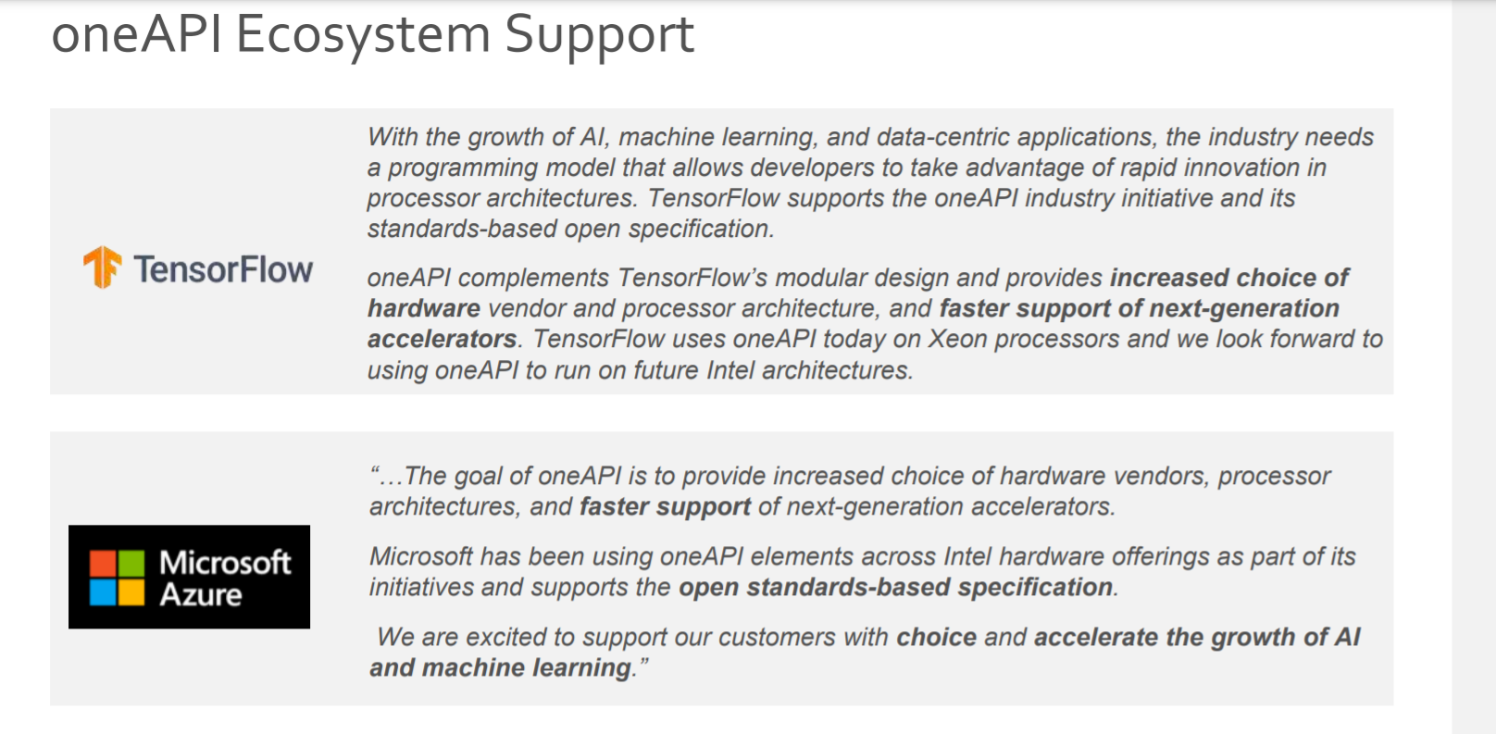

Slide 12
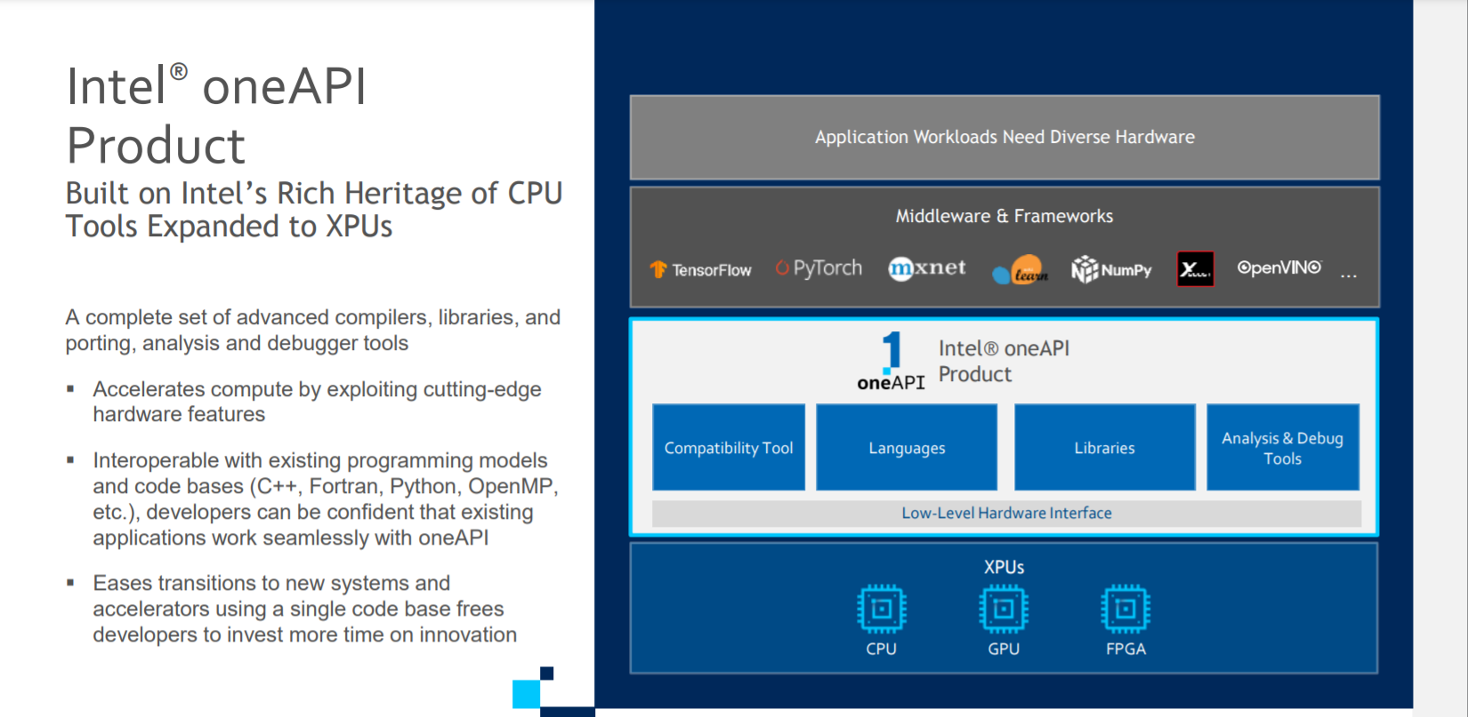

Slide 13
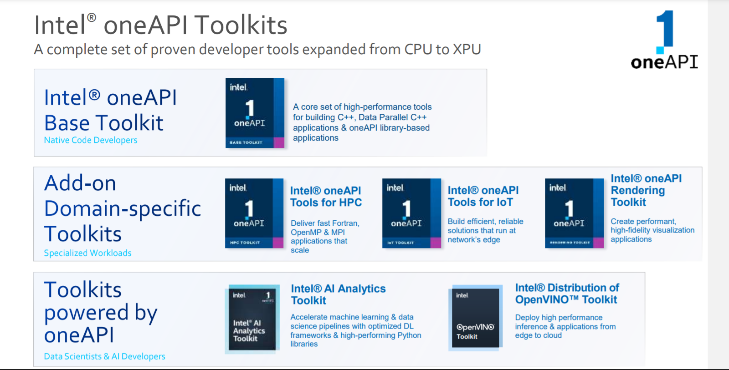

Slide 14
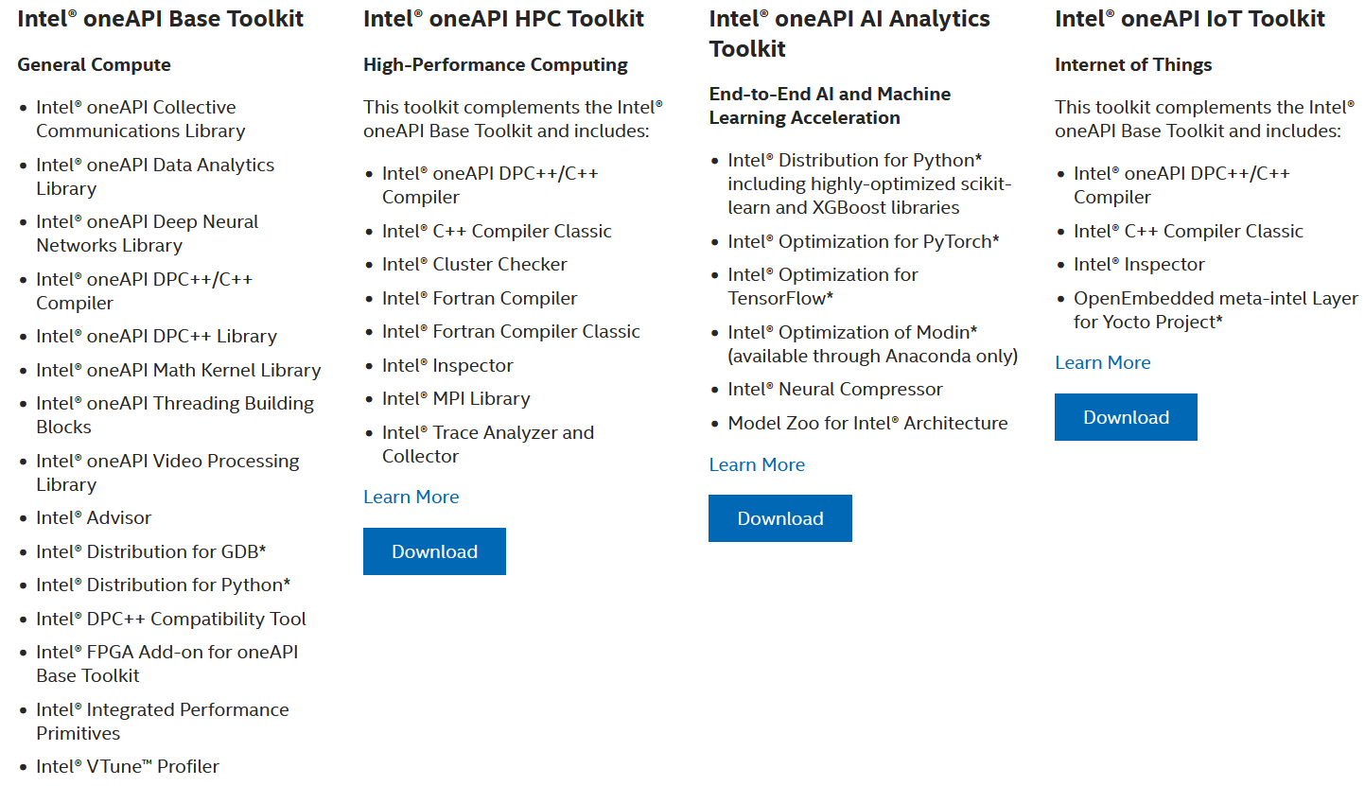
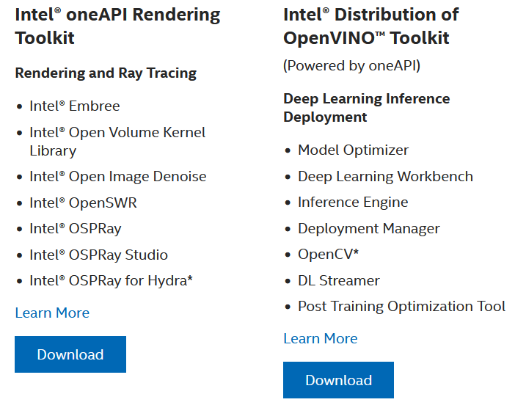
Intel OneAPI Toolkits
These toolkits are for performance-driven applications—HPC, IoT, advanced rendering, deep learning frameworks, and more—that are written in DPC++, C++, C, and Fortran languages.
Notes:
Intel Parallel Studio XE is a software development product developed by Intel that facilitates native code development on Windows, macOS and Linuxin C++ and Fortran for parallel computing.^{[2]} Parallel programming enables software programs to take advantage of multi-core processors from Intel and other processor vendors.
Intel Vtune amplifier- Stop guessing why software is slow. Advanced sampling and profiling techniques quickly analyze your code, isolate issues, and deliver insights for optimizing performance on modern processors.
Intel inspector- Locate and debug threading, memory, and persistent memory errors in applications early in the design cycle to avoid costly errors later.
Intel Advisor- Design and optimize high-performing code for modern computer architectures. Effectively use more cores, vectorization, and heterogeneous processing.

Slide 15
DPC++
oneAPI’s core language for programming accelerators and multiprocessors. DPC++ allows developers to reuse code across hardware targets (CPUs and accelerators such as GPUs and FPGAs) and tune for a specific architecture

Slide 16
OneDPL
A companion to the DPC++ Compiler for programming oneAPI devices with APIs from C++ standard library, Parallel STL, and extensions.
The oneAPI DPC++ Library (oneDPL) provides the functionality specified in the C++ standard, with extensions to support data parallelism and offloading to devices, and with extensions to simplify its usage for implementing data parallel algorithms.

Slide 17
OneDNN
High-performance implementations of primitives for deep learning frameworks
-oneAPI Deep Neural Network Library (oneDNN) is a performance library containing building blocks for for deep learning applications and frameworks. oneDNN supports:
CNN primitives (Convolutions, Inner product, Pooling, etc.)
RNN primitives (LSTM, Vanilla, RNN, GRU)
Normalizations (LRN, Batch, Layer)
Elementwise operations (ReLU, Tanh, ELU, Abs, etc.)
Softmax, Sum, Concat, Shuffle
Reorders from/to optimized data layouts
8-bit integer, 16-, 32-bit, and bfloat16 floating point data types

Slide 18
OneCCL
Communication primitives for scaling deep learning frameworks across multiple devices.
The oneAPI Collective Communications Library (oneCCL) provides primitives for the communication patterns that occur in deep learning applications. oneCCL supports both scale-up for platforms with multiple oneAPI devices and scale-out for clusters with multiple compute nodes.

Slide 19
Level Zero
A system interface for oneAPI languages and libraries

Slide 20
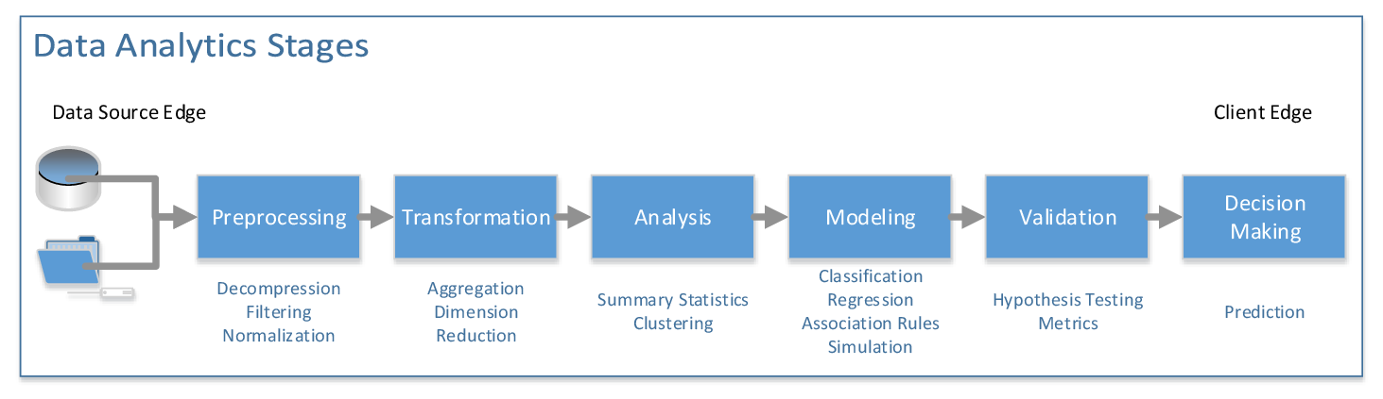
OneDAL
Algorithms for accelerated data science
oneDAL is a library that helps speed up big data analysis by providing highly optimized algorithmic building blocks for all stages of data analytics (preprocessing, transformation, analysis, modeling, validation, and decision making) in batch, online, and distributed processing modes of computation.

Slide 21
OneTBB
A library for adding thread-based parallelism to complex applications on multiprocessors.
oneTBB is a programming model for scalable parallel programming using standard ISO C++ code. A program uses oneTBB to specify logical parallelism in algorithms, while a oneTBB implementation maps that parallelism onto execution threads.

Slide 22
OneVPL
The oneAPI Video Processing Library (oneVPL) is a programming interface for video decoding, encoding, and processing to build portable media pipelines on CPUs, GPUs, and other accelerators. It provides device discovery and selection in media centric and video analytics workloads and API primitives for zero-copy buffer sharing. oneVPL is backwards and cross-architecture compatible to ensure optimal execution on current and next generation hardware without source code changes.

Slide 23
OneMKL
High-performance math routines for science, engineering, and financial applications
The oneAPI Math Kernel Library (oneMKL) defines a set of fundamental mathematical routines for use in high-performance computing and other applications. As part of oneAPI, oneMKL is designed to allow execution on a wide variety of computational devices: CPUs, GPUs, FPGAs, and other accelerators. The functionality is subdivided into several domains: dense linear algebra, sparse linear algebra, discrete Fourier transforms, random number generators and vector math.

Slide 24
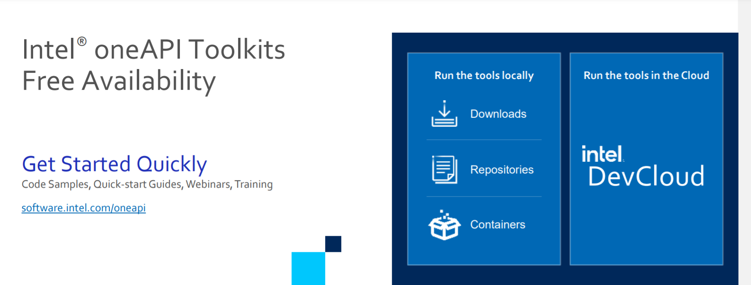
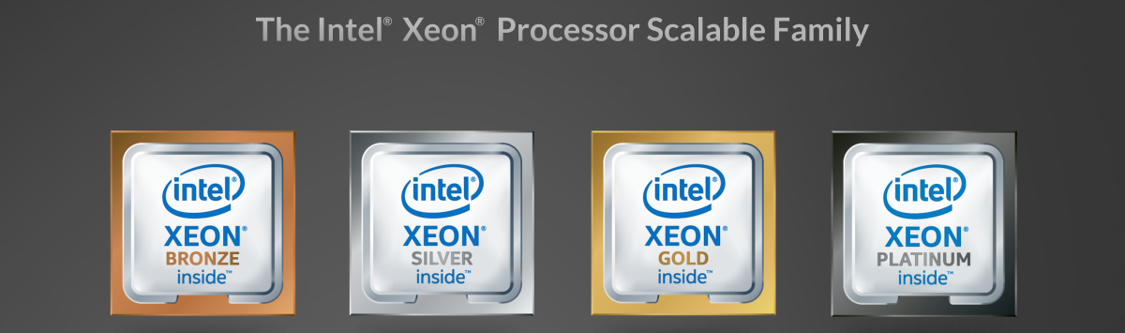
What is Intel Dev Cloud ?

Slide 25
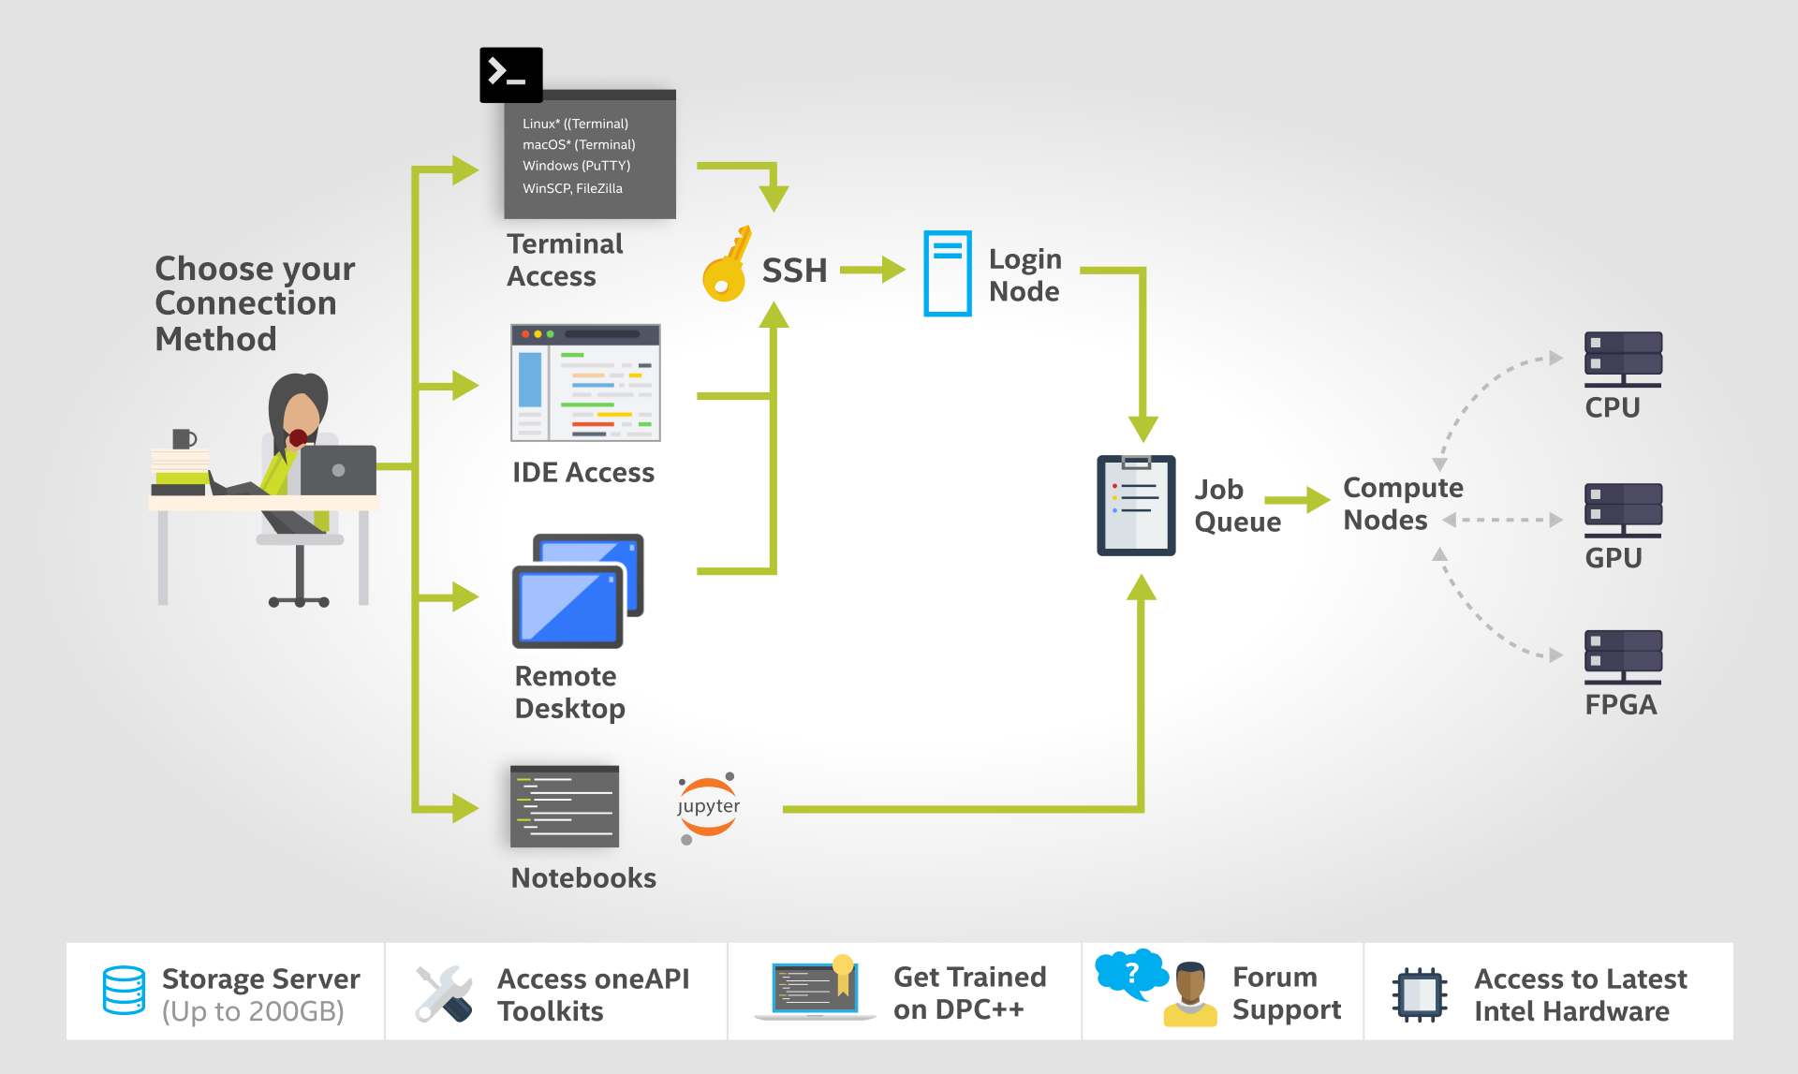
How DevCloud works?

Slide 26
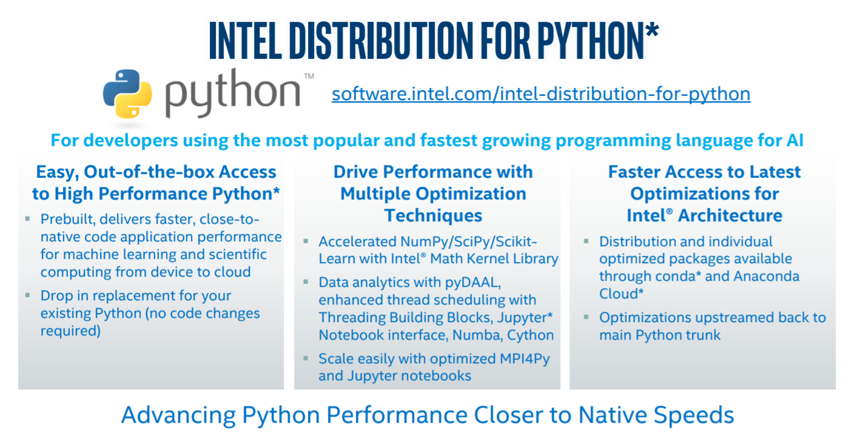

Slide 27
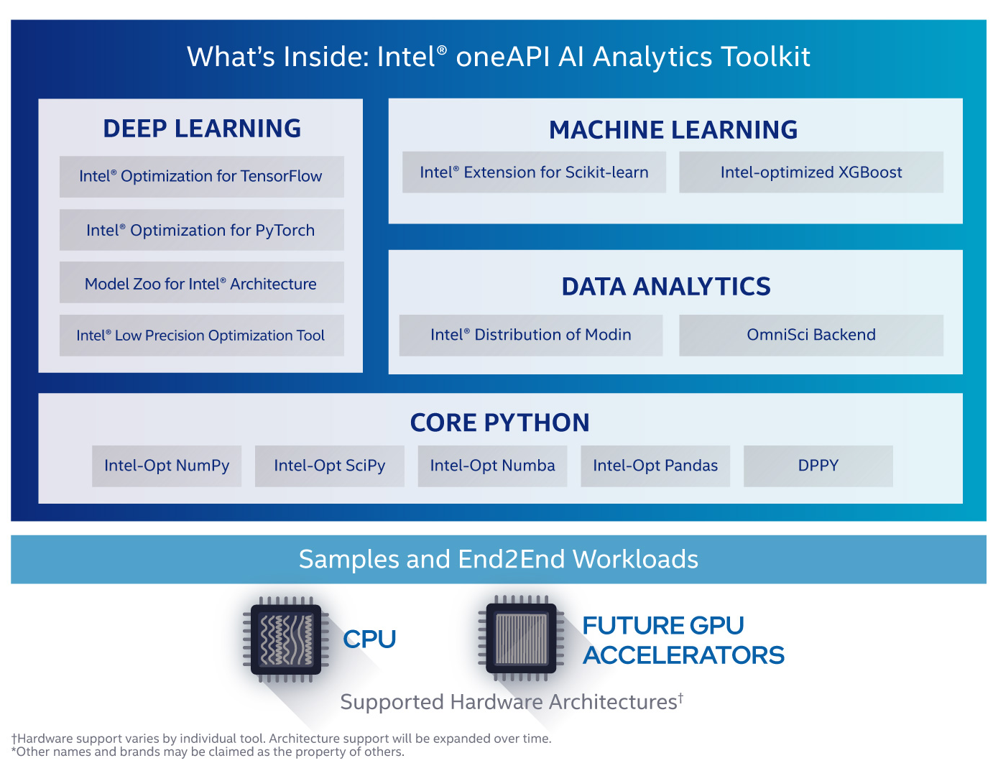

Slide 28
What software are required for this workshop?
Anaconda Software on Ubuntu
Intel Distribution of Python
Intel DevCloud for OneAPI

Slide 29
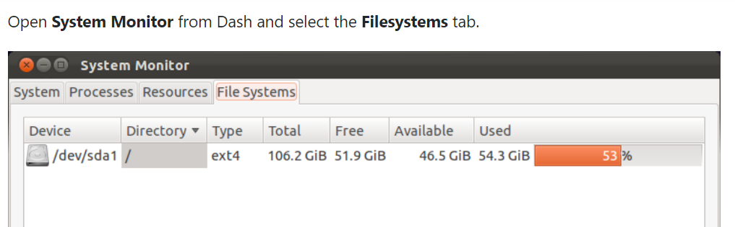
Important Ubuntu Commands
Check Ubuntu version
lsb_release –a
cat /etc/issue.net
Check Disk Space
df -h

Slide 30

Steps for downloading Intel Distribution of Python
Download Anaconda/Miniconda software
https://docs.anaconda.com/anaconda/install/linux/
Check Conda version
conda --version
Update Anaconda package
conda update conda

Slide 31
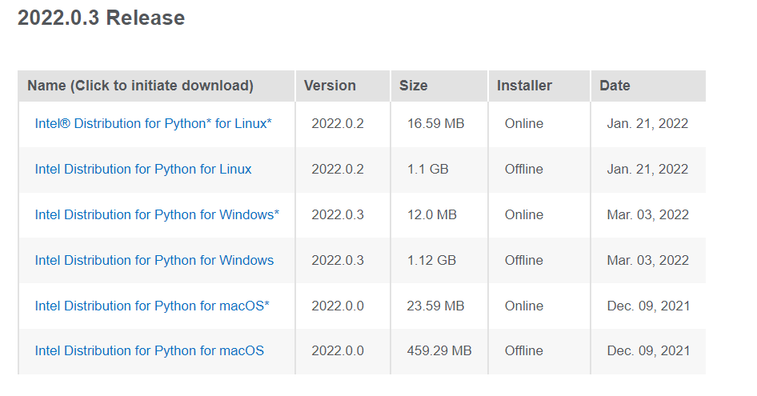
Intel Distribution of Python
https://www.intel.com/content/www/us/en/developer/articles/tool/oneapi-standalone-components.html#python

Slide 32
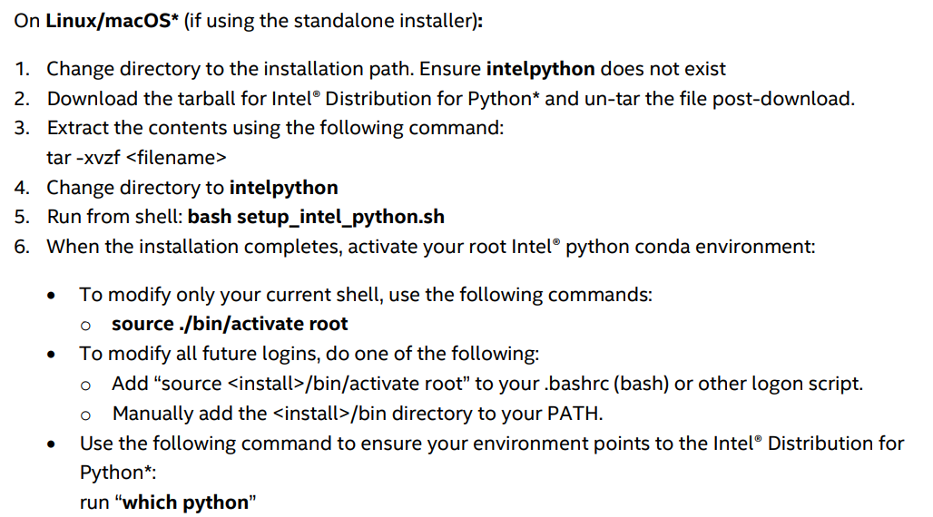
Intel Distribution of Python
https://www.intel.com/content/dam/develop/external/us/en/documents/2022_Python_Release_Notes_Intel(R)_Distribution_for_Python-Release1.pdf

Slide 33
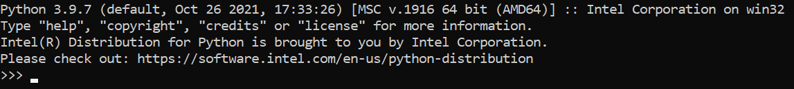
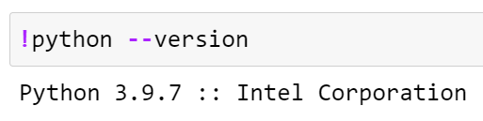
Checking if Python Intel is installed or not
On Anaconda Prompt, type python
In Jupyter Notebook, check the above statement in the code cell
Notes:
https://www.intel.com/content/www/us/en/developer/articles/tool/oneapi-standalone-components.html#python

Slide 34
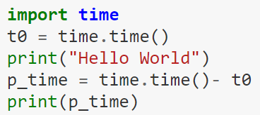
Time module in Python
%time
Use of time module from Python Standard library

Slide 35

Please contact
Foundation for Innovation and Collaborative
Education
mentor@fice.in
www.fice.in
Please contact
Foundation for Innovation and Collaborative
Education
info@fice.in
mentor@fice.in
Notes:
Here are the lessons we are going to learn today.

